Slide 1
Linux 0.11 nano version Introduction
Mar. 22th, 2018
Dezhux zhang

Slide 2
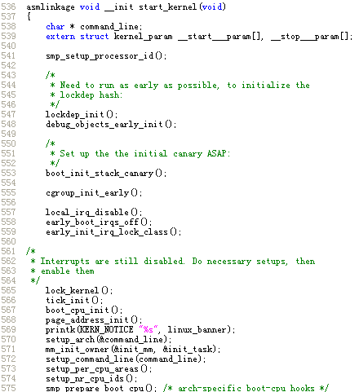
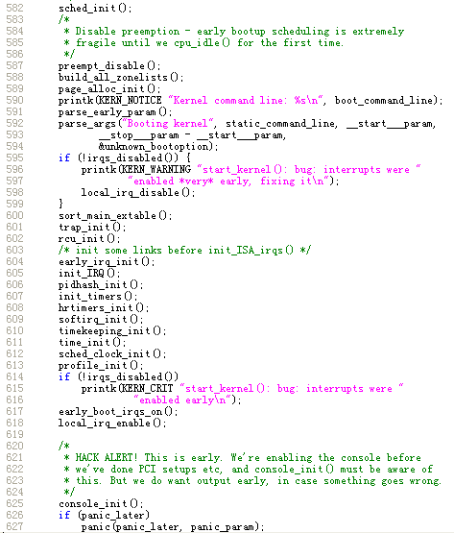
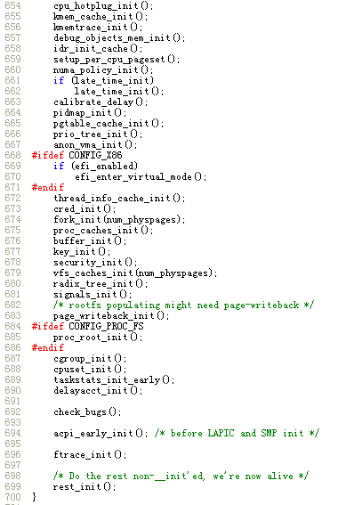
Is it valuable for us to spend time on linux-0.11 ??
Linux kernel work flow is always the same.
2

Slide 3
System kernel do what?
Bootrom(on x86 platform it is BIOS) read bootcode to mem and jump to run
Maybe bootcode to setup mmu address map, on x86 this is done by BIOS
Setup loading time stack and jump to C code
Setup a printk environment
Setup interrupt, especialy timer interrupt
Setup memory paging manage environment
Setup a kmalloc environment
Setup a Block/Char device read/write environment
Setup a File device environment
Setup a System Call environment
Setup a Process create and schedule environment
Load a shell program and run it, a script is also acceptable
Linux-0.11-nano shows step 1, 2,3
3

Slide 4
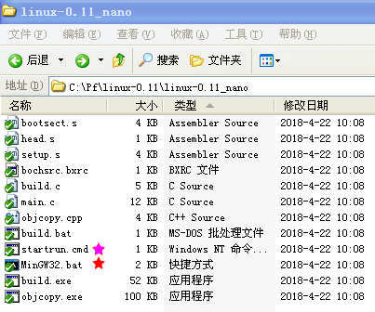
Build and Play 1/2
1. Double click MinGW32.bat
2. Input build.bat to build
3. Input startrun.cmd to run
4

Slide 5
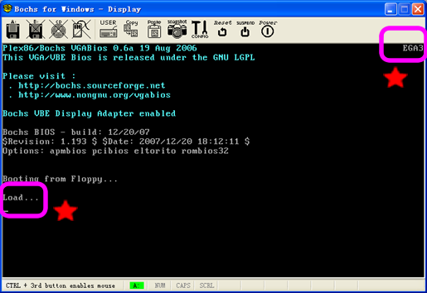
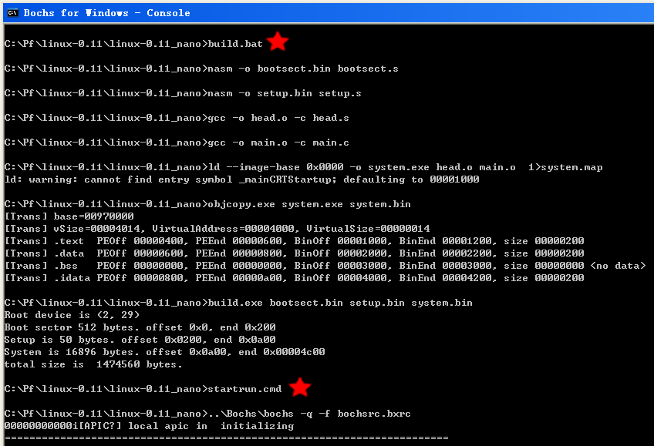
Build and Play 2/2
This is print by out kernel
This is print by bootsect
5

Slide 6
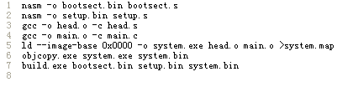
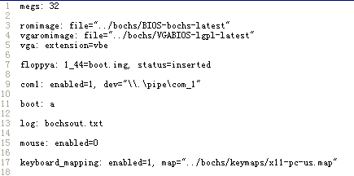
Build Steps
Assemeble bootsect.s to bin
Assemeble setup.s to bin
Compile head.s to object
Compile main.c to object
link
Strip system.exe to system.bin
Build floppy image to Boot.img
Run Steps
..\Bochs\bochs -q -f bochsrc.bxrc
6

Slide 7
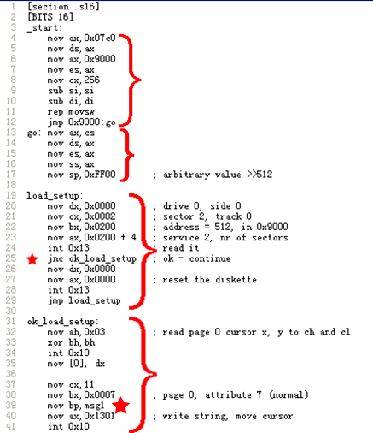
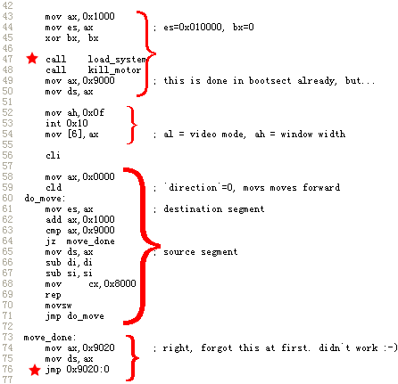
Bootsect.s 1/3 (165 lines)
Load system to mem
Copy code from 7c00
to 9000
Setup stack
Copy code from 9000
to 1000
Read setup to mem
Print “Load…” to notify user
Jmp to setup to run

Slide 8
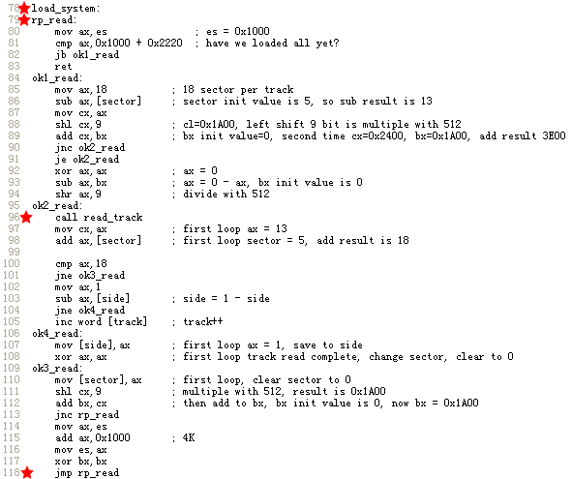
Bootsect.s 2/3
8

Slide 9
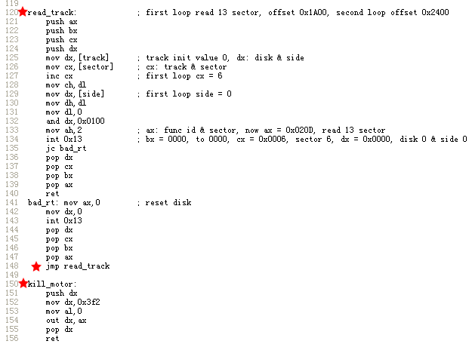
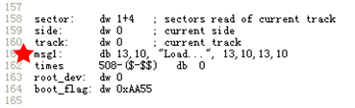
Bootsect.s 3/3
This is why we see a “Load…” output !!
9

Slide 10
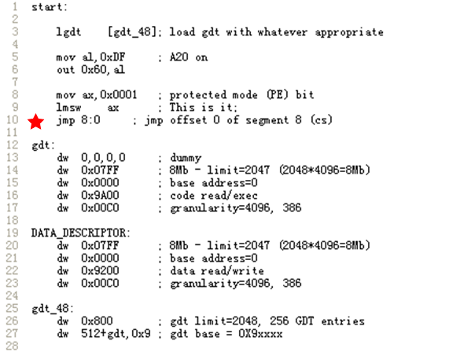
setup.s (28 lines)
Jmp to kernel head.s startup_32
10

Slide 11
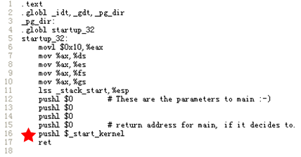
head.s (18 lines)
Jmp to kernel main.c
11

Slide 12
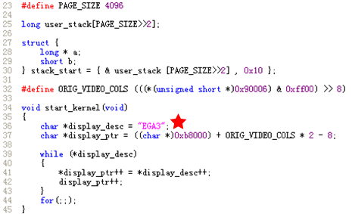
main.c (23 lines)
This is why we see a EGA3 output !!
12

